Slide 1

Market Profile
Presented By-
Jay Ajmera J004
Atharva Rode J056
Kallind Soni J065

Slide 2

Content
What is Market Profile?
TPO
POC
Value Area
Types of Days
Our Model (Code, Visualization and Strategy)

Slide 3
What is Market Profile?
A Market profile is a chart that displays information on market activity, combining price, volume and time frame information on a single chart. The chart displays price information on a vertical scale, or the y-axis, count information on the horizontal or x-axis.

Slide 4
TPO (Time Price Opportunity)
Time Price Opportunity, simply means Time regulates price, thus presenting opportunity.
Time Price Opportunity (TPO) is a building block of a Market Profile chart.
Each TPO represents a point of time where the market traded at a specific price.
A single TPO is displayed on the chart every time the price touched it during the same period of time.
The default and most common settings of TPO are in 30-minute time intervals.
The same prices are displayed on the TPO chart only if the market returns to trade them during another 30-minute period during the trading day.

Slide 5
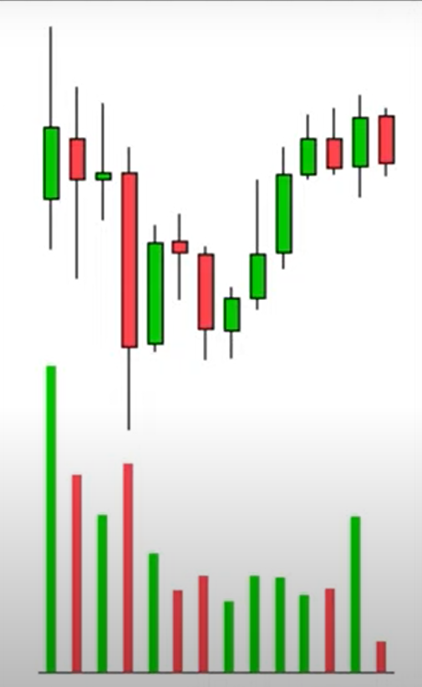
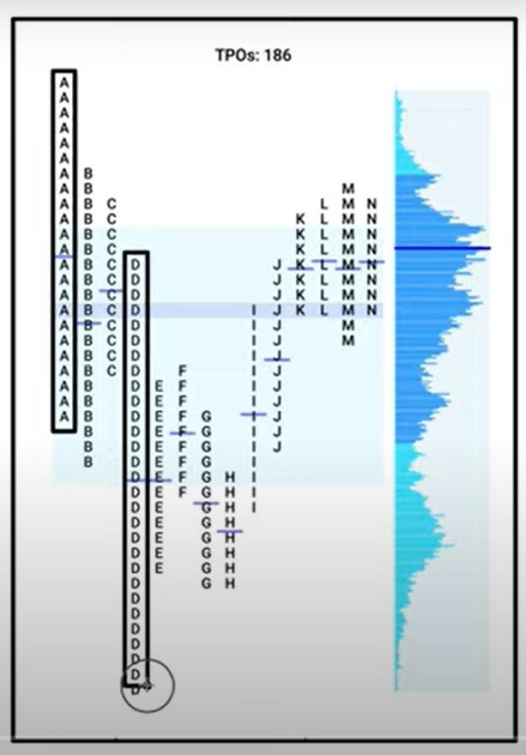
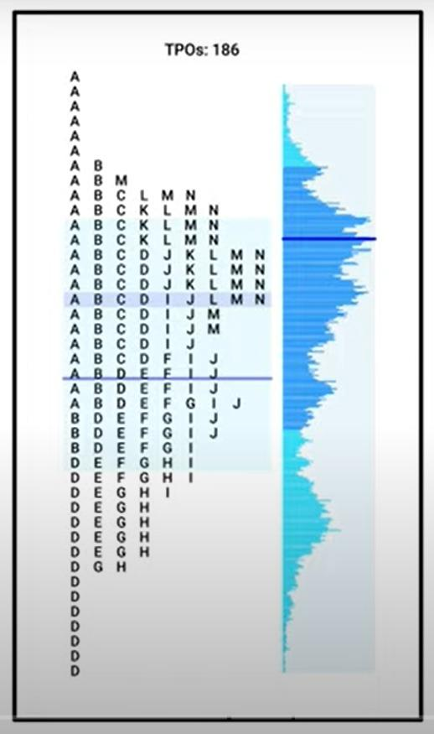
Notes:
Normal Day
The most basic day structure is the Normal Day. It is easy to follow and understand as most of the day activity is in the initial Balance or the first 60 minutes of the day session. On a Normal day, the bell curve also develops within the range of the initial balance( IB) and does not go much beyond the initial balance. There is often limited range extension and the market returns into the IB for the close.
( To understand the different terms like Initial Balance etc look up – https://vtrender.com/market-profile-terminology/)
Normal variation day
This is the most common of the different day auctions we see in Market Profile. On this day we will see a range extension outside the Initial Balance and often the market continues it’s probe on the same side as the break of the initial Balance and goes to complete the probe by extending to 2 times the Initial Balance Range ( high to low) and in some cases even 3 times of the IB
We also see the value built higher/ lower on such days and is a pointer for continuation in the coming sessions.
( To understand the different terms like Range extension etc look up – https://vtrender.com/market-profile-terminology/)
Neutral day
This is again a Day based on the Initial Balance or IB.
In this day we find the Initial balance is slightly smaller than a Normal day or a Normal Variation day. Price makes a move away from this initial balance early in the session but is not successful in creating a good range extension. It then comes back in the IB and travels through the IB and makes an attempt at a range extension on the other side of the IB.
Accordingly based on the second attempt of the range extension we have 2 types of Neutral Days
a) Neutral Center: In this type of day the second attempt of the range extension is also not successful like the first one and the market comes back into the IB and closes near the day center or midpoint or even Vwap or Dpoc. On such days we consider both the buyers and sellers as equal in strength and the close in the middle as a fair close.
b) Neutral Extreme: In this type of day the second attempt of the range extension is successful and the market finishes the day at one extreme which is often the day’s highs or lows as the case may be. In this day type, either the buyer or the seller is considered more stronger than the other and gives us a very good context to watch for continuation.
( To understand the different terms like vwap/ dpoc etc look up – https://vtrender.com/market-profile-terminology/)
Non-trend day
This is characterized by a narrow range day with a fat profile. There seems to be random rotation with little price movement on either side of the profile, thus developing a short and fat profile.
These days can occur prior to important announcements, long weekends or holidays, or at market exhaustion points. Most traders will simply complain that the market is choppy and untradable on these days.
It is when the market is making a narrow range that a large range, and possibly trend day, will occur in the next day or two.
( To understand the different terms look up – https://vtrender.com/market-profile-terminology/)
Trend day
A trend day will usually begin with a small initial balance, However, early in the day structure range extension occurs. This range extension does not allow a value area to develop in the initial balance, and the range extension continues throughout the day. These days are seen as having Higher Highs and Higher Lows ( OR LH/ LL) in every 30 minute period.
There are often periods of single prints on the profile. Most importantly, there is very little rotation from time period to time period. In other words, each half-hour segment drives prices further in the direction of the trend.
Sometimes one of the time segments will have a bit of rotation in the opposite direction, but the price usually will resume the trend. In such cases, we keep an eye for a pullback high or a pullback low to develop which is the afternoon adjustment of inventory. The range of a trend day is wide and the profile absent, the rotation is thin. Obviously the open will occur at one end of the trend day, and the close will be near the opposite end.
( To understand the different terms like Initial Balance/ Range extension etc look up – https://vtrender.com/market-profile-terminology/)
Double distribution trend day
A variation on the trend day is the double distribution trend day. This day starts off much like a trend day, however, there begins a rotation with a bell curve beginning to develop in the initial part of the day. It appears that more of a normal variation day will come about.
But then new information enters the market and range extension occurs and drives prices to a new area. At some point the move is shut off, usually overshooting, and then another bell curve begins to develop. The resulting profile will have two areas of price rotation, which are usually separated by an area of single prints.
These days can often occur on surprise announce or event occurs. The market goes from balance to imbalance as the news drives the market to a new level, and then back to some sort of balance as the information is digested.

Slide 7
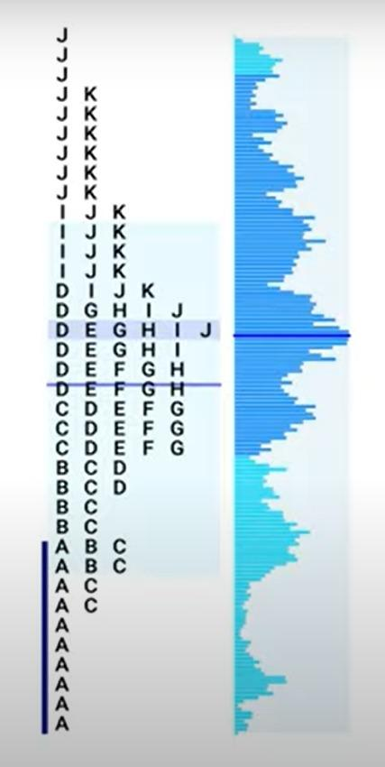
POC (Point of Control)
Price where the most trading occurred (longest line of TPOs).This price is also known as the "point of control," because it's the price that had control of the market the most.

Slide 8
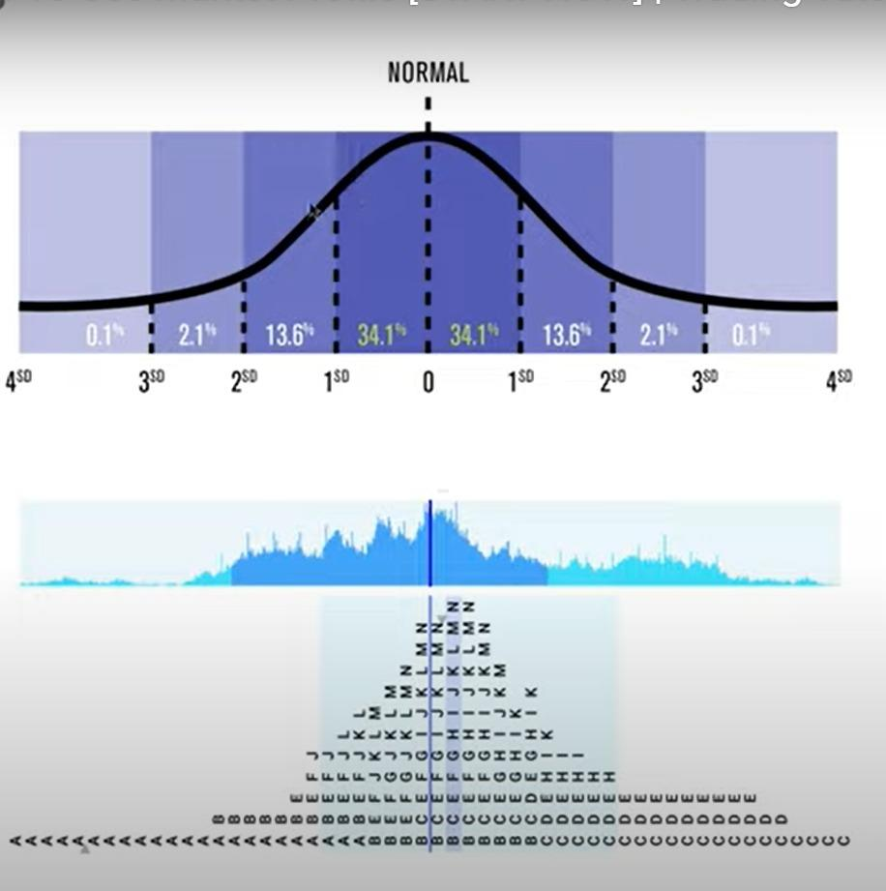
Value Area
Value Area – Where 70% of the day’s trading took place.
Value Area High (VAH) – The upper level of value area.
Value Area Low (VAL) – The lower level of value area.

Slide 9
Types Of Days
Normal Day
Trend Day
‘P’ Day
‘b’ Day

Slide 10
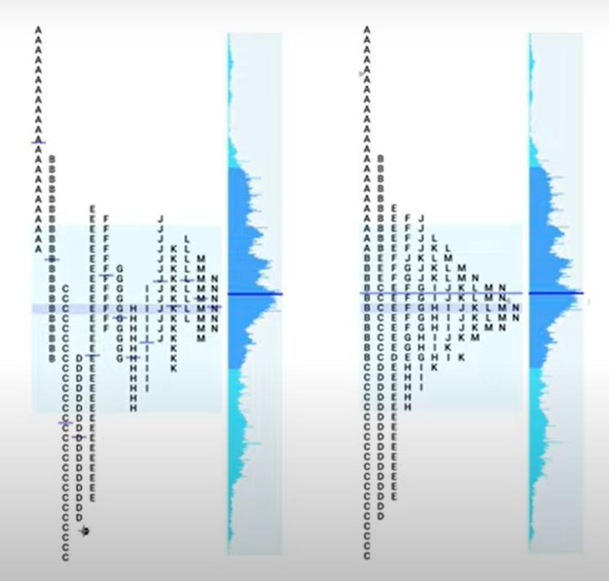
Normal Day
The most basic day structure is the Normal Day. It is easy to follow and understand as most of the day activity is in the initial Balance or the first 60 minutes of the day session.

Slide 11
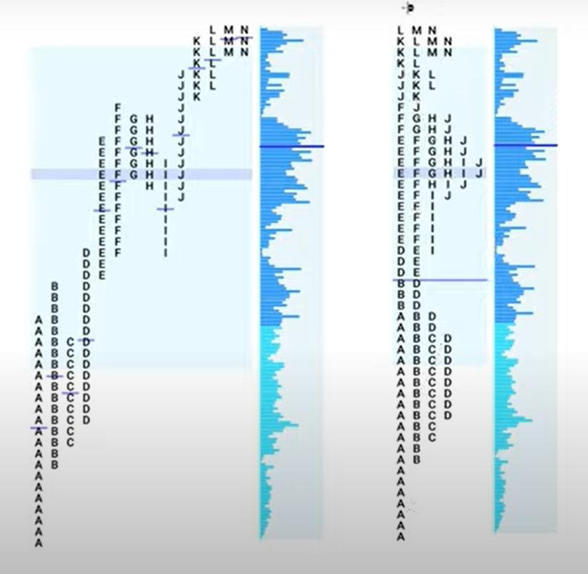
Trend Day
A trend day will usually begin with a small initial balance, However, early in the day structure range extension occurs. This range extension does not allow a value area to develop in the initial balance, and the range extension continues throughout the day. These days are seen as having Higher Highs and Higher Lows ( OR LH/ LL) in every 30 minute period.
There are often periods of single prints on the profile. Most importantly, there is very little rotation from time period to time period.

Slide 12
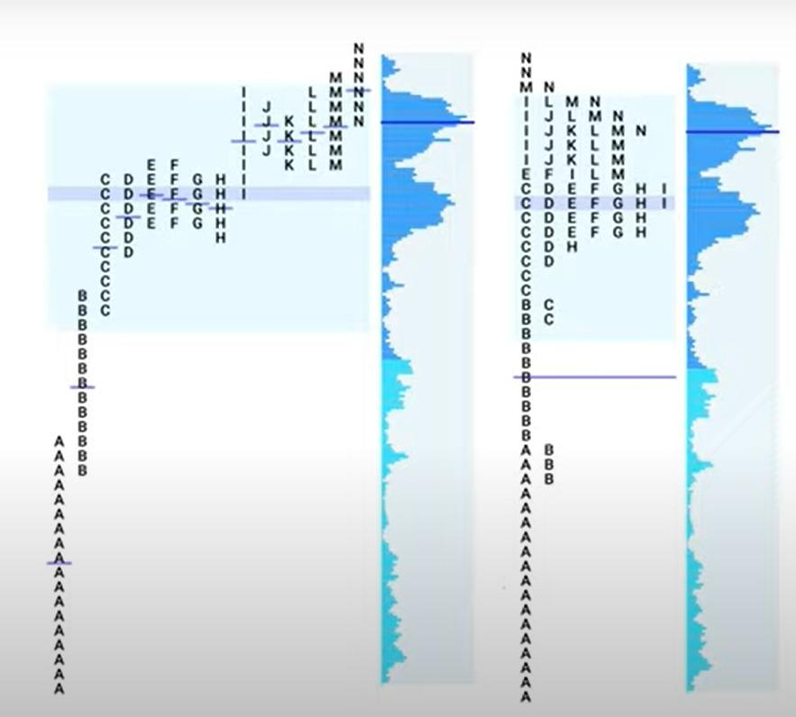
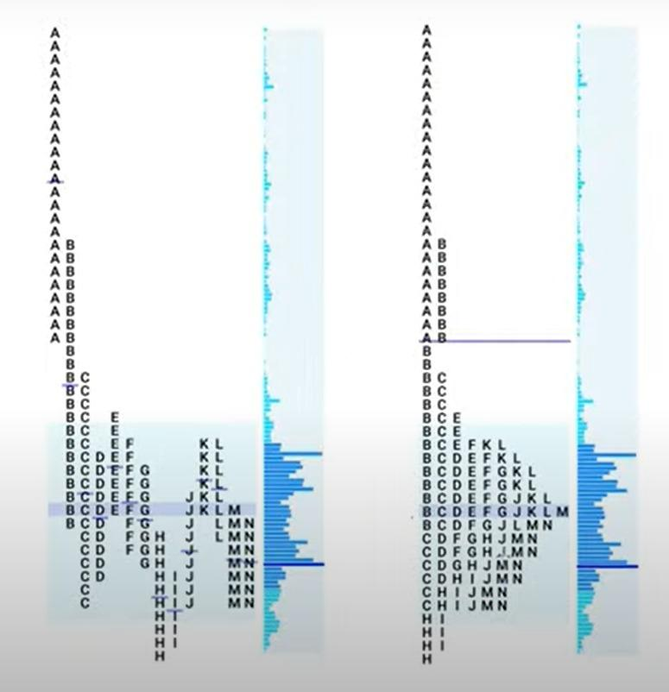
‘P’ DAY
P-shape profile signals a short-covering which means that the market rally early in the sensing and spends the rest of the day distribution and creating a profile that looks like a letter P.

Slide 13
‘b’ Day
B-shape profile signals long exiting, the market drops early in the session, and spends the rest of its distributing, creating a profile that looks like letter b.

Slide 14
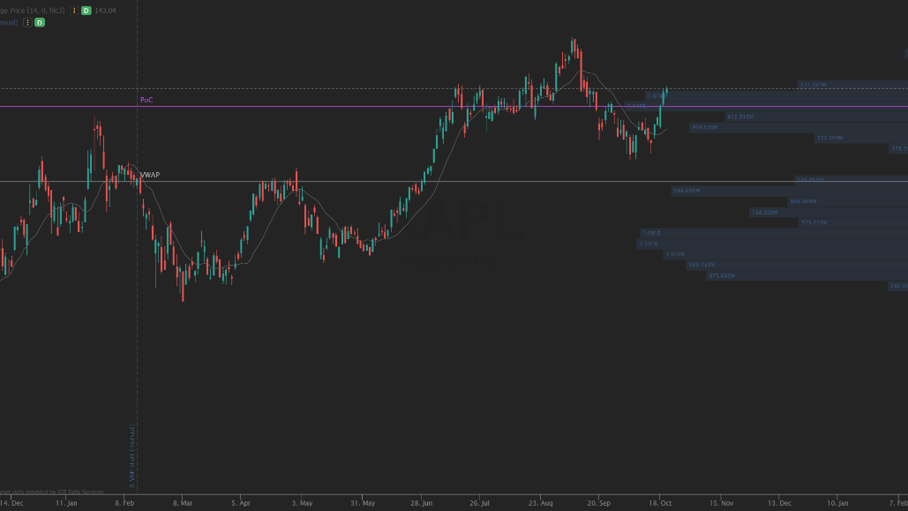
Analysing Market Profile and Its Strategies

Slide 15
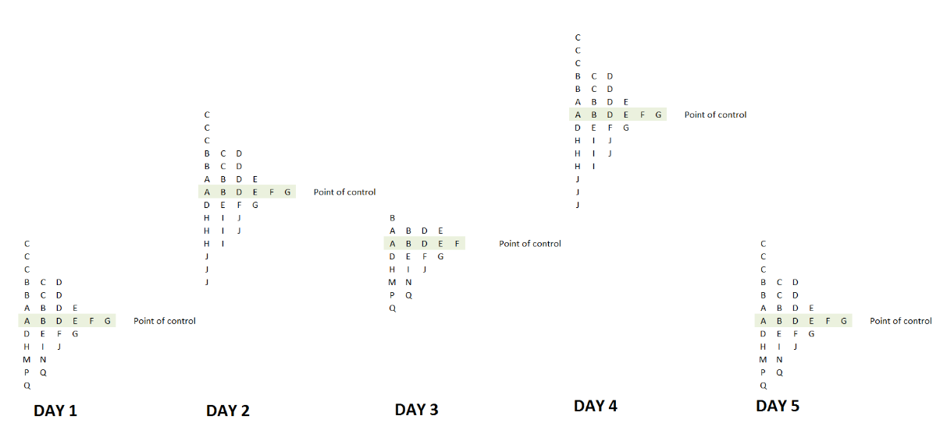

Slide 16
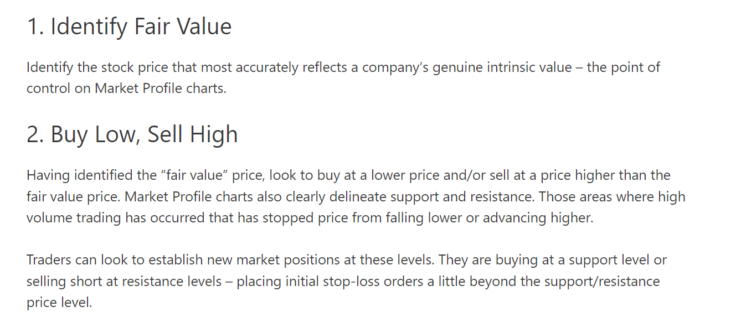

Slide 17

Let’s look at our Model
Opening Jupyter Notebook….

